Slide 1




Team 4 members: Gina Villegas Jason XINGCHI Zhang Matt Janousek
Enabled by a Joint Operation of
WELCOME TO PROJECT: DR. ME

Slide 2
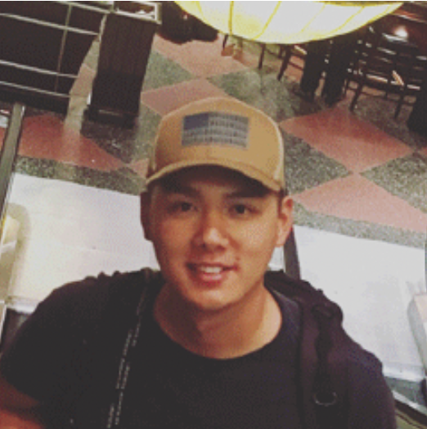
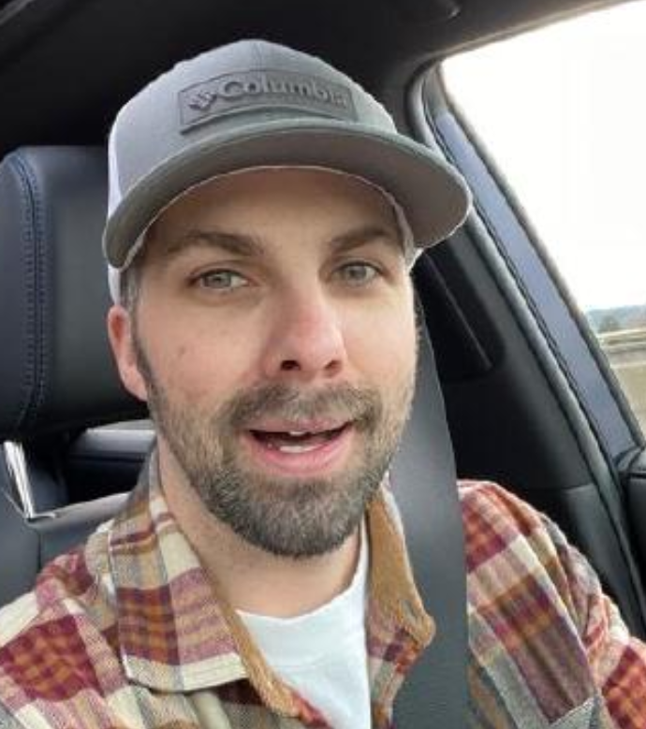
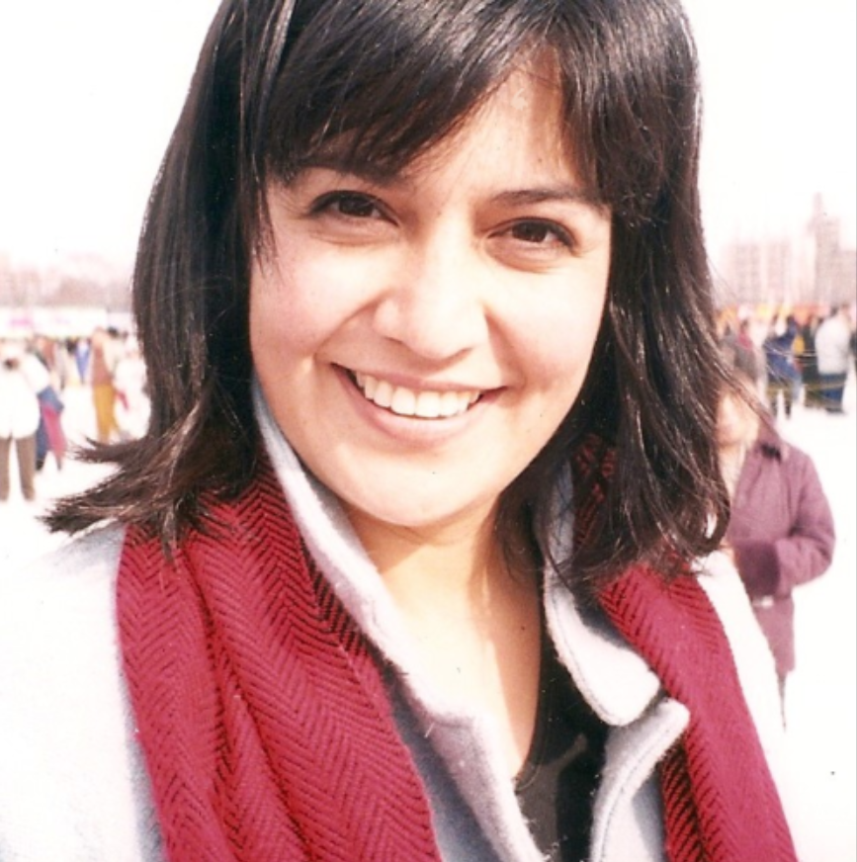
Meet the team
Jason Xingchi Zhang - Amazon military apprentice
Matt Janousek - Amazon military apprentice
Gina Villegas - Amazon military apprentice

Slide 3

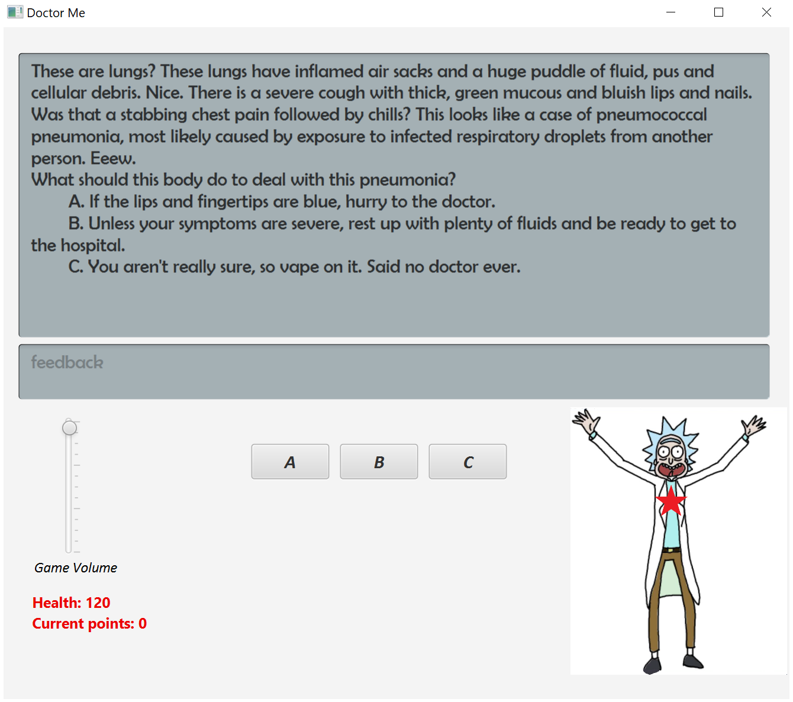
Dr. Me is a java-based game featuring javafx graphics. It was created implementing agile methodology.
Let’s Dive In

Slide 4
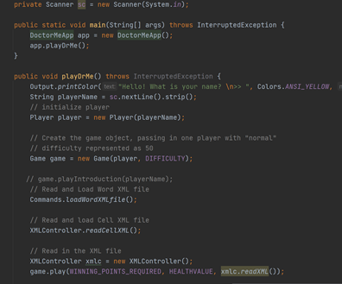
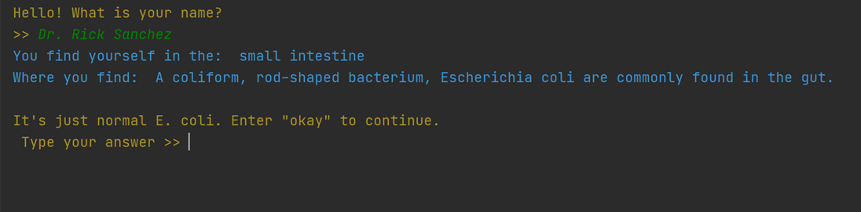
Where we began
- The only thing we know about the project is that it is supposed to be a text-based game.
- We take over the console version of the game from another team without knowing how it works what it does.
- We clone the repo and run the code to learn what is does and understand how it works.
- Meanwhile, communicate to understand and get to know each team member.
- As a team, We brainstorm on the next steps, e.g., features to develop, selection of tech stacks, feasibility study.

Slide 5
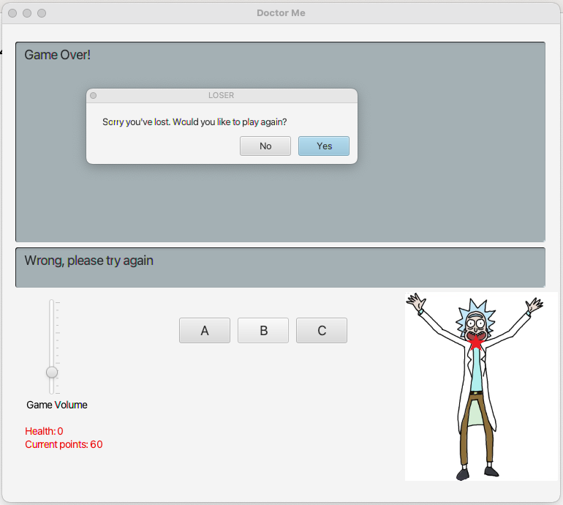
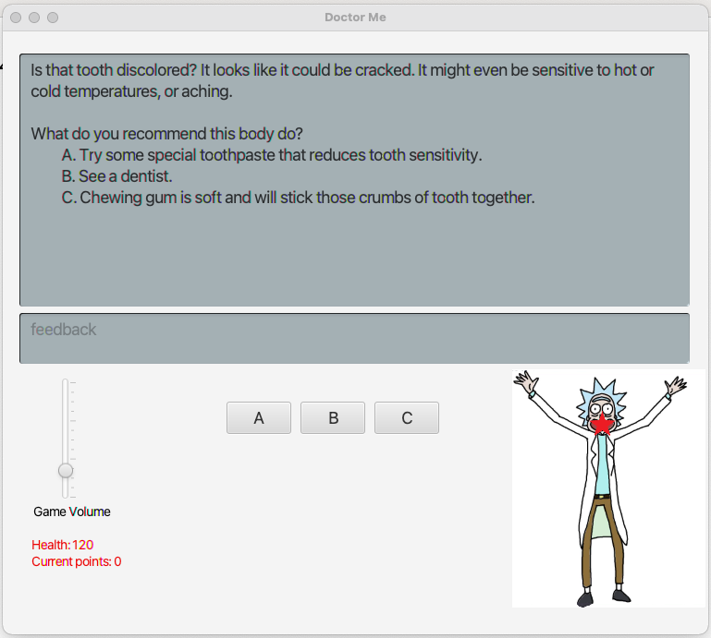
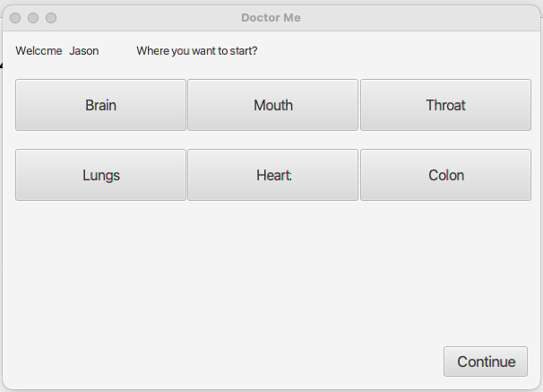
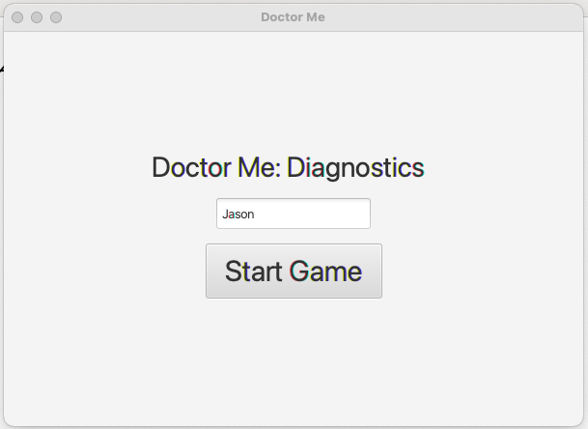
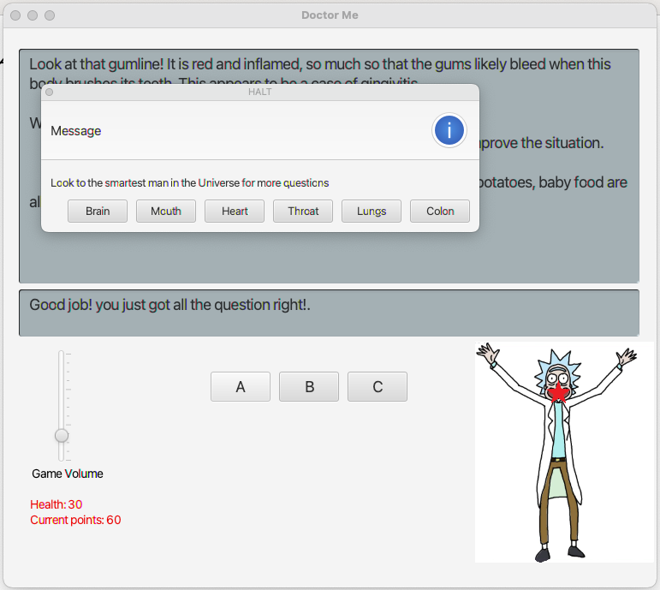
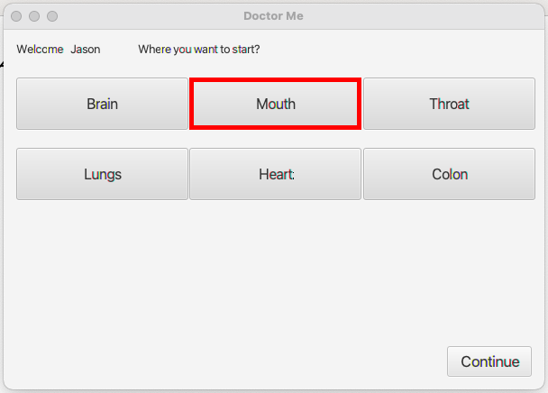
Where we ENDUP
- We understand what the legacy code base does and how it works by leverage debugger.
- We have solid understanding of Agile software development.
- We adopted JavaFX an open-source next generation client application platform for desktop, mobile and embedded systems built on Java.
- We extend features such as traverse the body, added music and volume control, visual representation of current location.
- We have executable jar release for both Windows OS and MacOS.

Slide 6
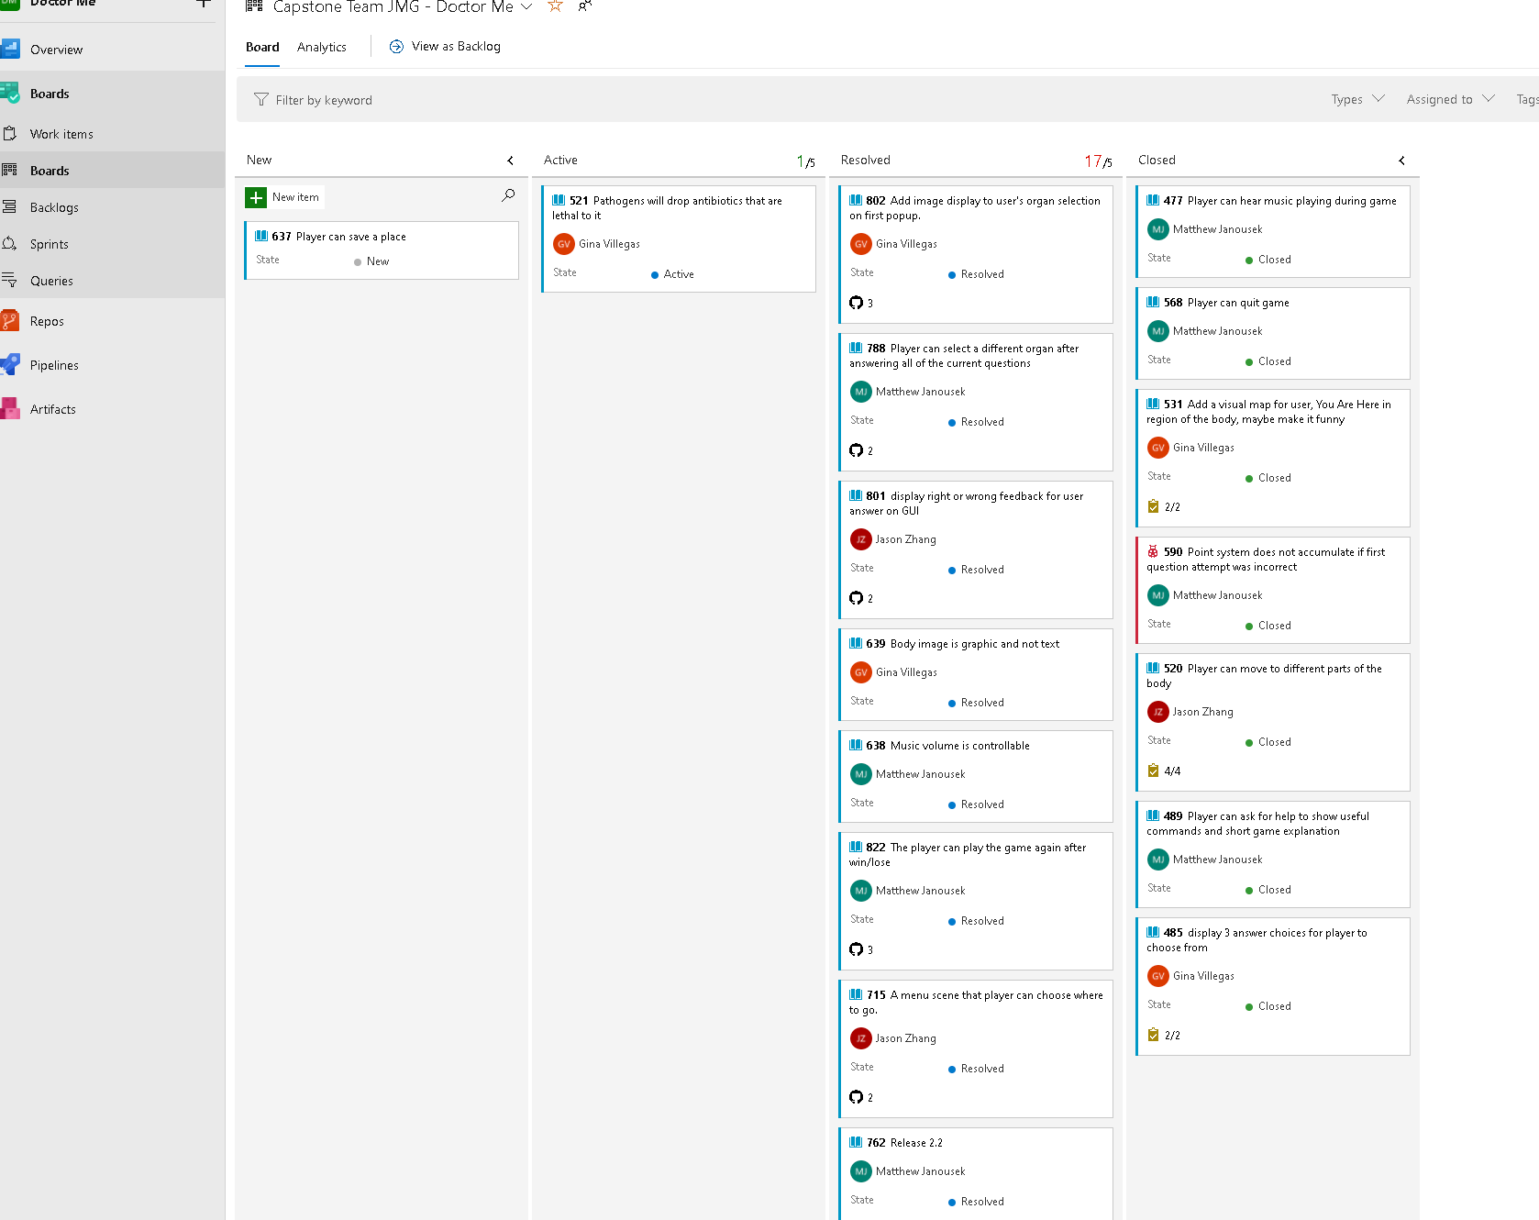
Kanban
What is devOps
Agile development
Spring
User story
Associate branch with ticket number
Backlog

Slide 7
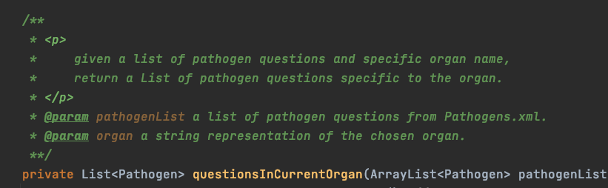
Jason
- name variable with meaningful name
- keep method small and just do one thing
-

Slide 8
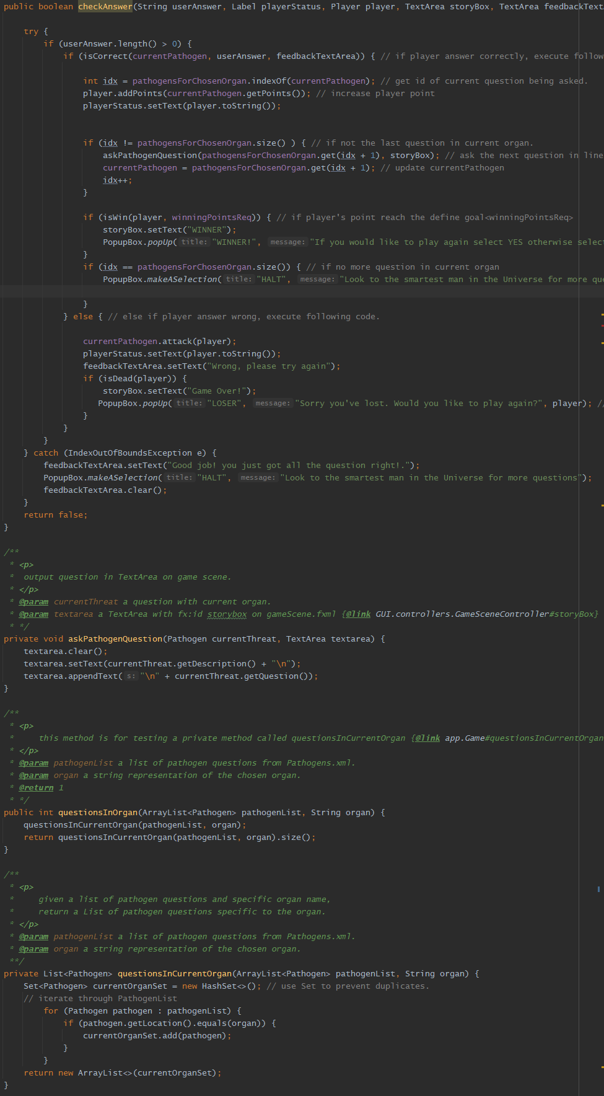
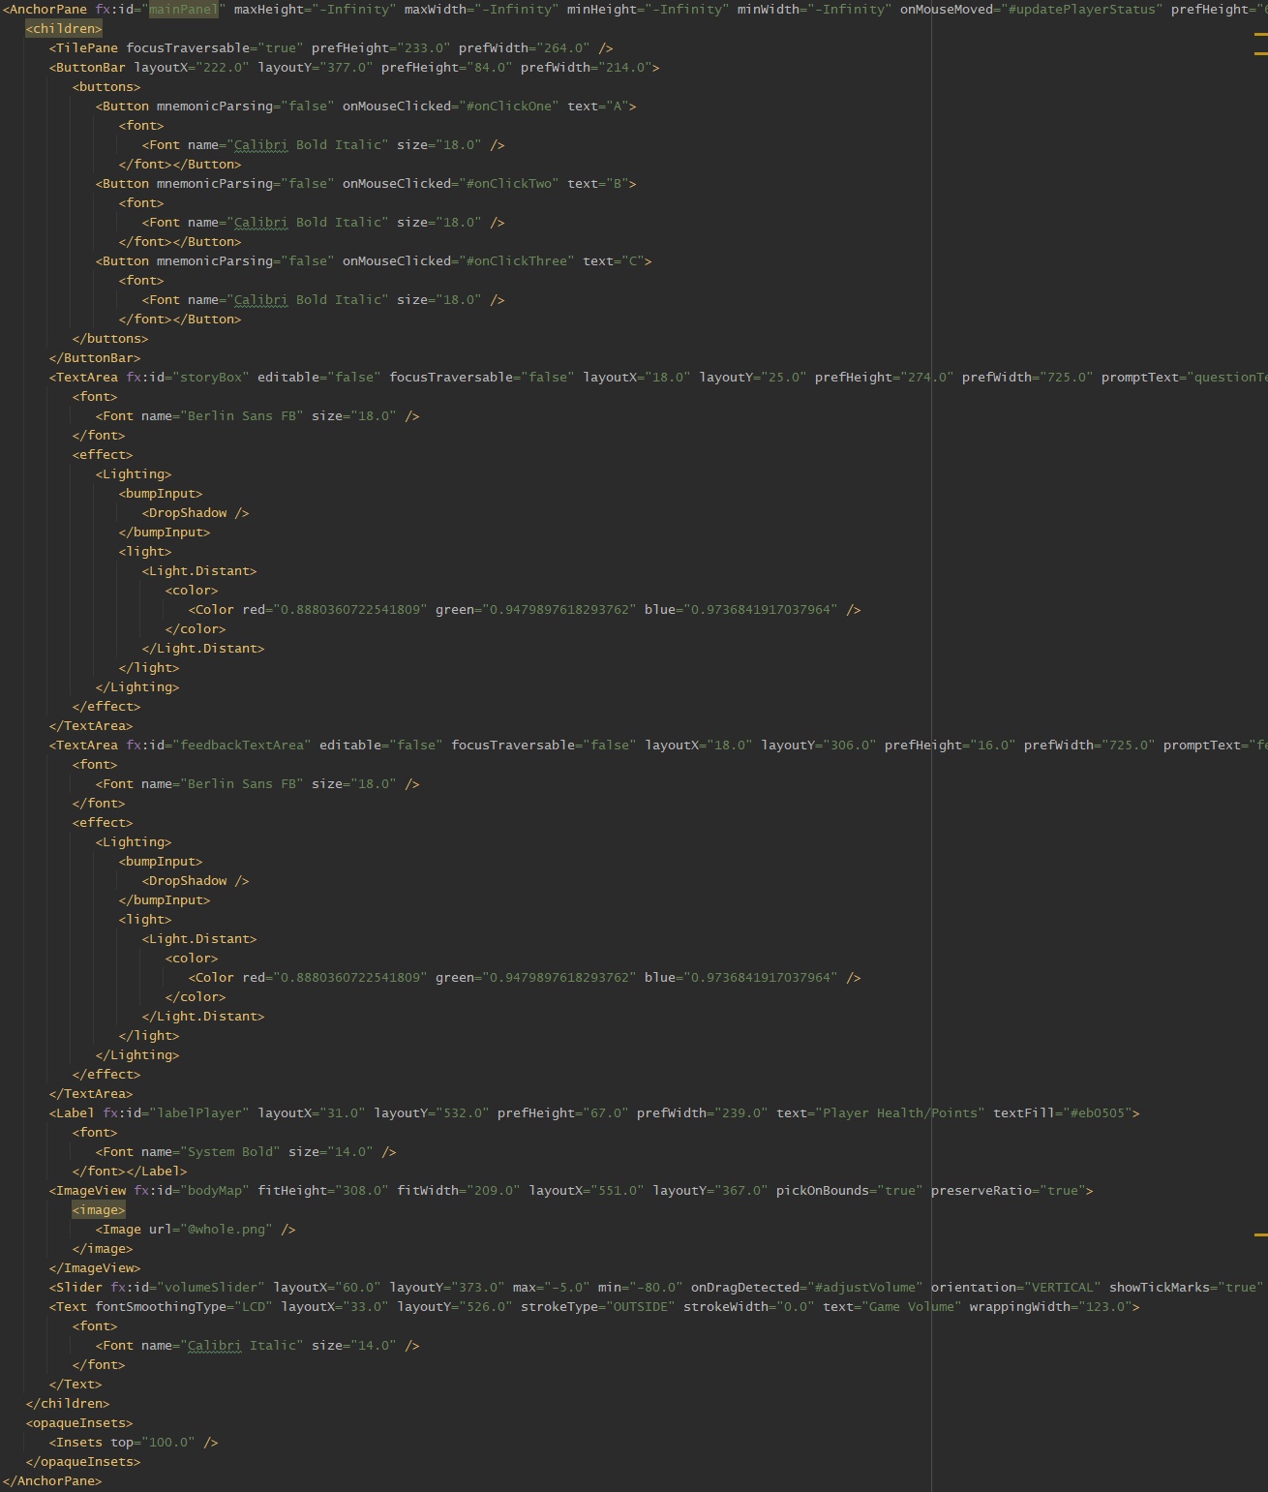
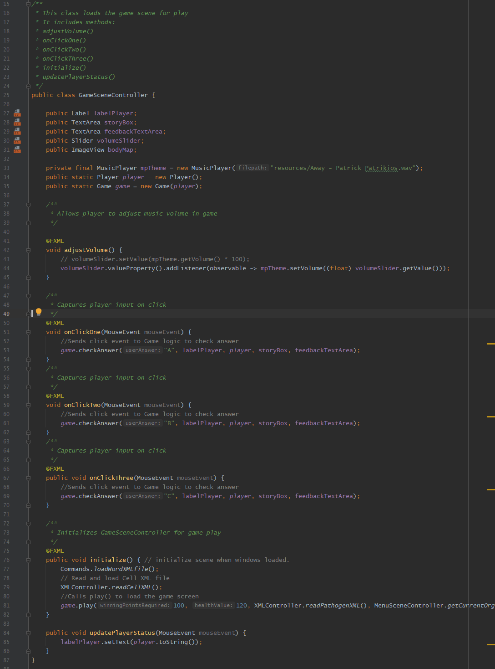
Matt

Slide 9
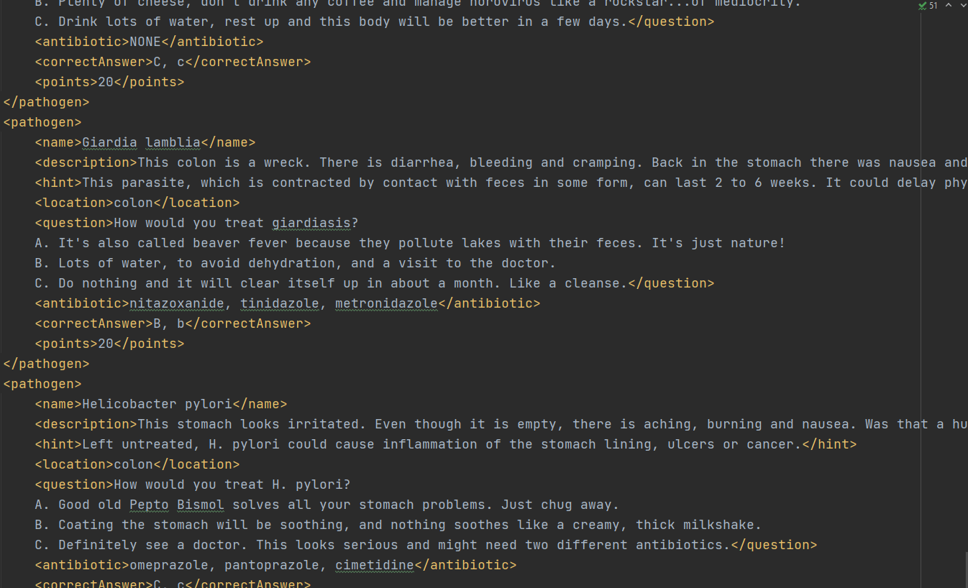
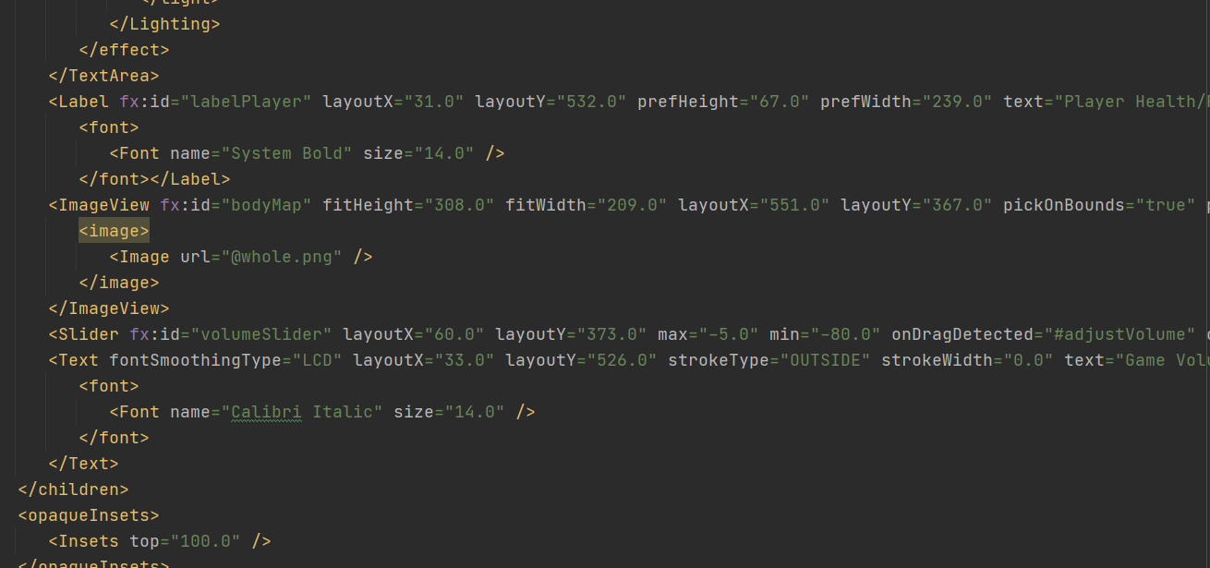
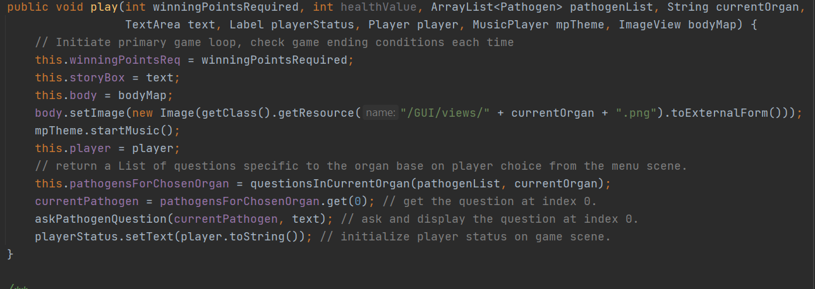
gina

Slide 10
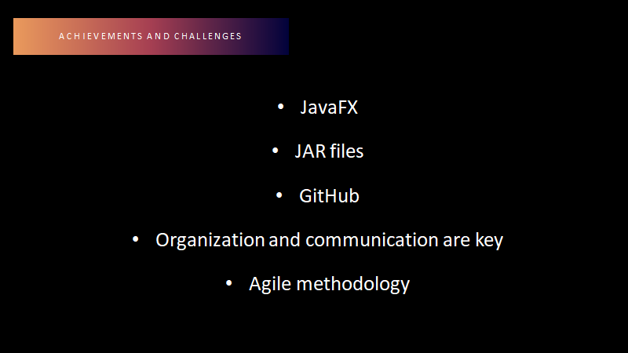

Slide 11

Future Goals
Create Responsive version
Make it available in all app stores
Market to Adult Swim Channel

